Slide 1


BDAB x ClearSkye
Spring 2021 Final Deliverable

Slide 2







Our Team
Ahmed Baqai
Arshia Singhani
Bryce Fang
Ethan Shedd
Project Manager
Project Manager
Consultant
Consultant
Justin Wong
Kaitlyn Zhang
Surya Mamidyala
Consultant
Consultant
Consultant

Slide 3
Agenda
01. Initial Exploration
02. Rules
03. Data Cleaning
04. Model Experimentation
05. Fine tuning
06. Next steps

Slide 4
01
Initial Exploration

Slide 5
Initial Exploration
Research
Data
EDA
Attribute-Based Access Control or Role Based Access Control
Come up with relationships of the data we would like to explore
Clean the Data for Exploratory Data Analysis (EDA)
Analyzed data tables and created visualizations to deepen our understanding of the data
Notes:
Research about similar problems and existing approaches, see how we can apply and modify to come up with our unique solution
RBAC (given access to entitlements based on role title)
ABAC (given access to entitlements on a multitude of features including title, seniority, typical tasks, environment, location, etc)
ABAC is more prominent in industry, we thought it would better suit our needs so we’re going with this
Data
Got familiarized with the data
Came up with 5 potentially interesting relationships within the data that we wanted to explore - for ex: location & entitlement, position & entitlement, etc.
We used multiple metrics to clean the data, which we’ll talk about later in this presentation
EDA
Analyzed data tables and created visualizations to deepen our understanding of the data
We then used this understanding to create our rules, which bryce will talk about now

Slide 6
02
Rules

Slide 7
Rule 1
Inputs: User, Entitlement, Target Feature
Check Semantic Similarity
If returns 0
Run a semantic similarity check with the nltk library on the desired features and entitlement assignment
Run Entropy-Weighted Frequency
Take the frequency that the value of the target feature occurs in the entitlement, and multiply it by the inverse of the entropy
Notes:
Use nltk to get the “closeness” of the meaning of two words (primarily used for comparing job titles). If it returns 0, that means the words aren’t semantically similar. Move to second part, entropy-weighted frequency. Takes a naive prior distribution of how likely a member of the target entitlement is to have a matching target feature and combines it with the inverse of the entropy (1/entropy+1), as more variation in the target feature makes it less likely to be a good indicator of entitlement fit

Slide 8
Rule 2
Inputs: User, Entitlement, Target Feature
Check Feature Similarity
Returns proportion of other accounts (such that their feature is the same as the target account feature) that have access to the entitlement in question
Provide an Indication
A simple color-based indication is provided corresponding to whether the given account - entitlement pair is reasonable
Notes:
Second rule is inverse of first rule. Given an entitlement and an account, we collects all the other accounts present in the data such that their feature is equal to the target account feature, then we return the proportion of accounts that have access to the entitlement. Based on this proportion, we provide a color indication corresponding to whether the given account - entitlement pair is reasonable or not reasonable. The color indications we provide are red, yellow, and green. Green and yellow suggests that the given account - entitlement pair can be accepted with green signifying a higher level of confidence, while red signifies that the account should not be given access to a certain entitlement and that this specific pairing should definitely be further investigated by HR.
I’ll pass it over to Bryce again to talk about data cleaning.

Slide 9
03
Data Cleaning
Notes:
Vital for
Understanding data
Training model

Slide 10
Initial Cleaning Stage
Deep Cleaning Stage
Dropped columns containing ID hashes
List created with every entitlement and its corresponding accounts
Notes:
Phase before rule definition
Drops columns pertaining to identification (not useful for predictions)
Creates a list that maps all the entitlements with their accounts

Slide 11
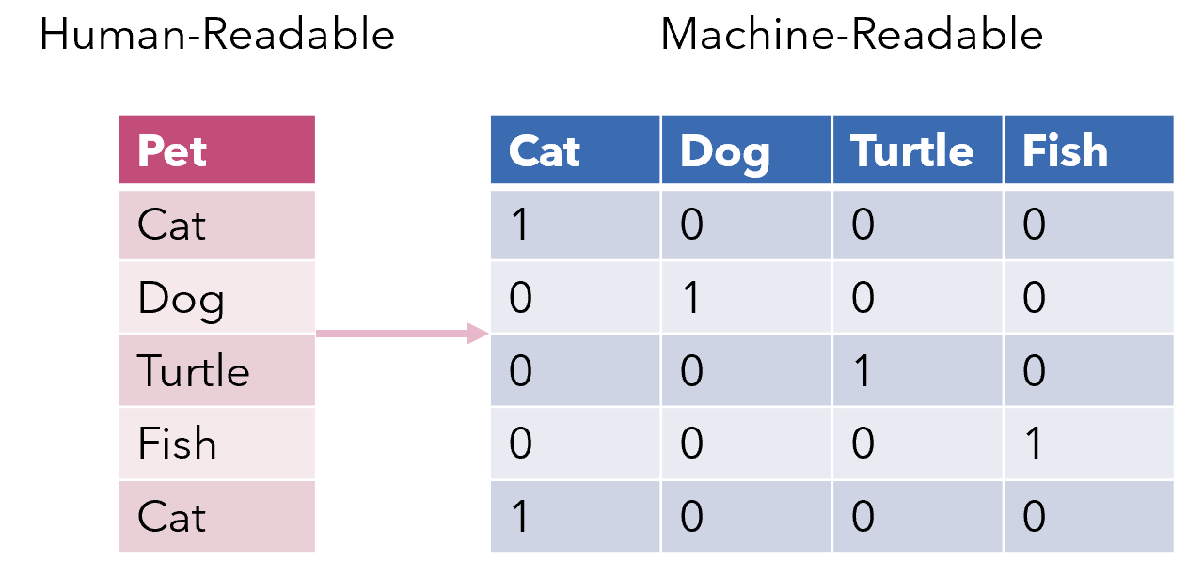
Initial Cleaning Stage
Deep Cleaning Stage
Prune columns containing only one or no values
Split job titles into individual words
One hot encoding
Correct N/A data
Shorten column names
Notes:
Post rule generation
Cuts out columns with no information
Split up job titles into individual words to allow focus on each aspect of the position
One hot encoding to address qualitative data (transforms qualitative into discrete quantitative using binary values)
Addresses problematic void areas by filling with meaningful “empty” values
More column pruning based on relevance to a prediction
Shortening column names for ease

Slide 12
04
Model Experimentation
Notes:
What they are, what they do, and what we want to do with them

Slide 13
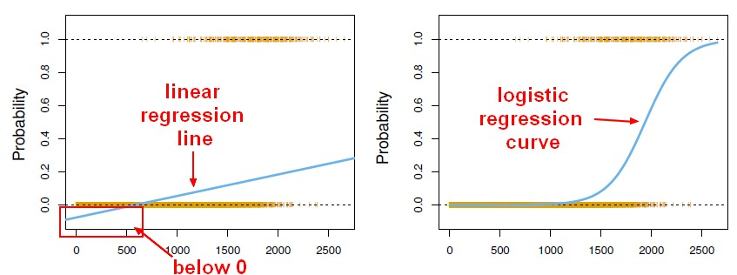

Logistic Regression
Equation
Classification
Threshold
1 = Yes
0 = No
If the predicted probability is above 50%, we predict a 1
Notes:
Logistic Regression:
Similar to linear regression
Equation
Classification
Threshold

Slide 14
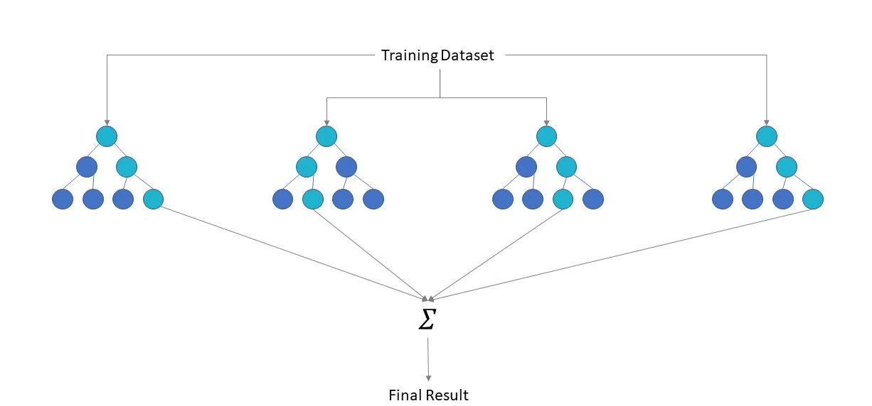
Random Forest
Group of Decision Trees
Random Features
Majority Rule
Notes:
Random Forest
Decision Trees
Random Feature for each tree
Majority rule

Slide 15
Pros and Cons
Logistic Regression
Random Forest
Strengths
Easy to understand, quicker to train
Good accuracy for simple models
Can do well with both linear and nonlinear relationships
Generally provides a high accuracy
Weaknesses
Not as accurate for more complex relationships
Assumed log linearity between features
Harder to interpret
Takes longer to train

Slide 16
It can be a good idea to combine the two models
Depending on the linearity between the features and the entitlements for each company, the logistic regression and random forest models can compensate for each others’ weaknesses.
Notes:
Strong vs weak confirmation
Predict proba

Slide 17
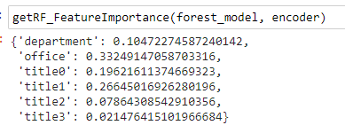
Feature Importance
The function get RF_FeatureImportance displays the relevant importance of each feature to the model.
Notes:
An interesting attribute of the random forest model is its feature importance. This basically tells us how much weight the model gives to each of the different features for the prediction. In our model’s case, the features were department, office, and role which was split up into the four features called title for every word in the role
- For example, with the given sample data the office had the most weight, which means that the office feature of the dataset had the greatest effect on the random forest model's prediction (whether the account-entitlement pairing should be accepted)

Slide 18
05
Fine Tuning

Slide 19
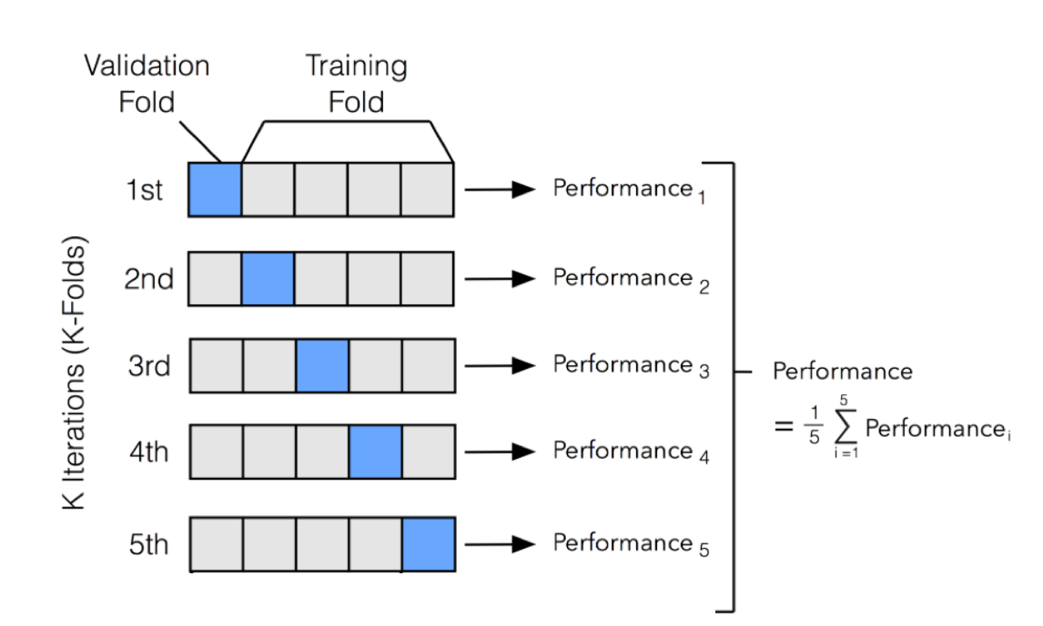
Cross Validation
GridSearchCV
Currently tuning MaxFeatures parameter
Other features to tune include number of leaves, sample depth, and number of estimators
Increased training time

Slide 20
06
Next Steps
Notes:
Along with this presentation, we created a whole Jupyter Notebook
Could help HR person in charge of reviewing entitlement-account pairings because the model could be used to spit out a color indication that they can aid their judgement or if the model is robust enough, its color indication could determine whether the entitlement-account pairing should be accepted and automating this way removes human manual verification -> saves money, time
Shortcomings: fake data and for rules specifically, Wordnet database used only finds semantic relationships between English words, so trying to adapt the model to other languages like French or Chinese would mean that Clearskye would have to use a different natural language processing library like Wordnet that works for other languages
Test the rules and ML models on more robust data - can get an accuracy and see how to fine tune from there. We provided tools like GridSearch and cross validation to help optimize the model once you have valid data.

Slide 21
Thank you!
Notes:
questions?

